Slide 1
DDS Debugging
AD9910 Verilog & Board Debug

Slide 2
Glitch Problem
Profile 000->011 makes 001 010 oftenly

Slide 3
Possible Causes
1. Metastable → need SYNC utility of AD9910 to solve
2. Transmission line → low possibility
3. FPGA problem → ARTY S7 connected to DDS had problem

Slide 4
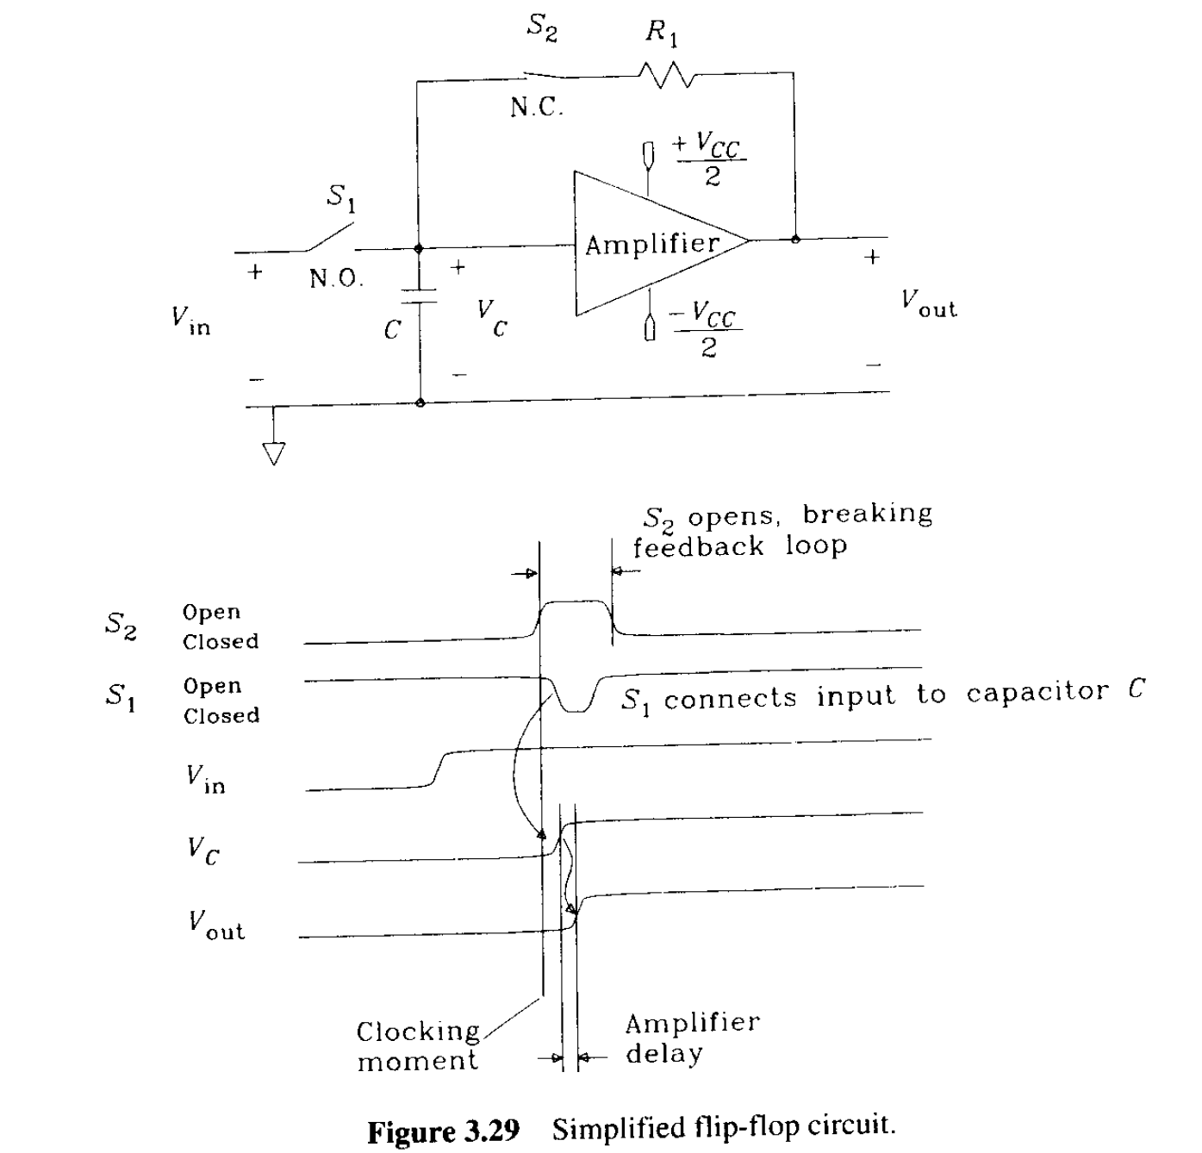
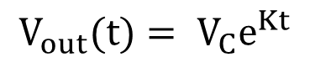
Metastable
D flip flop
D Q
CLK
$$V_{out}(t)= V_{C}e^{Kt}$$
D
CLK
Q
Simplified flip-flop model
S1 close, S2 open works as a clock edge event

Slide 5
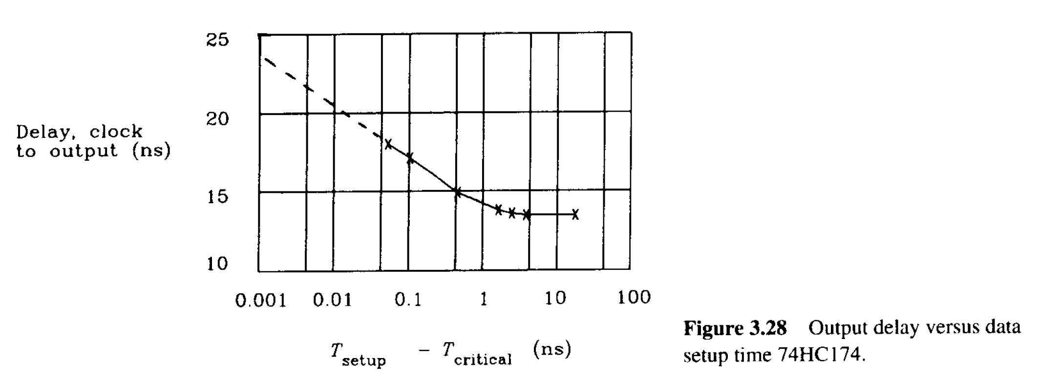
Metastable
D flip flop
D Q
CLK
Input Signal should not change in setup hold time
→setup hold time condition
D
setup
hold
CLK
Q

Slide 6
Final Cause
if setup+hold ~= 2ns -> 1-(8/10)*(8/10) = 9/25 -> 36% of glitch probability
setup-hold time violation!
Profile[2]
Profile[1]
Profile[0]
setup
hold
SYNC_CLK
Profile[2]
register
metastable
Profile[1]
register
Different time of profile signal arrival time
→ Only one profile pin cause change in input buffer register
see https://ez.analog.com/dds/f/q-a/29655/ad9914-profile-change-problem
NIST and M-Labs suffered from same issue with AD9914 and AD9910 respectively. see https://github.com/m-labs/artiq/issues/1994

Slide 7
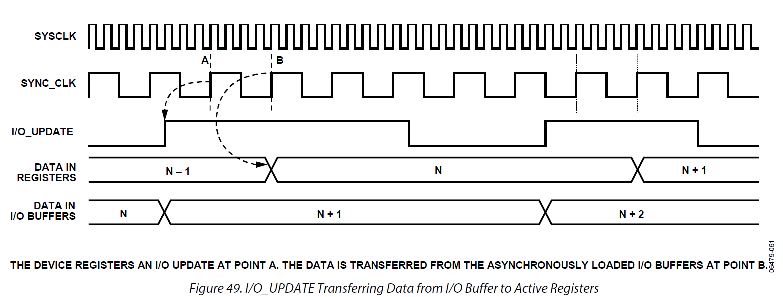
Non perfect solution
Send IO Update Manually
Do not use internal IO Update utility!(make CFR2[23] = 0)
Same with using two D flip-flop

Slide 8
Experiment for timing
adjust delay
1GHz CLOCK
delay control
AD9910
spectrum analyzer
ARTYS7
profile change
frequency
f1
f2
f3
f4
profile
000
010
001
011
Validation of our assumption

Slide 9
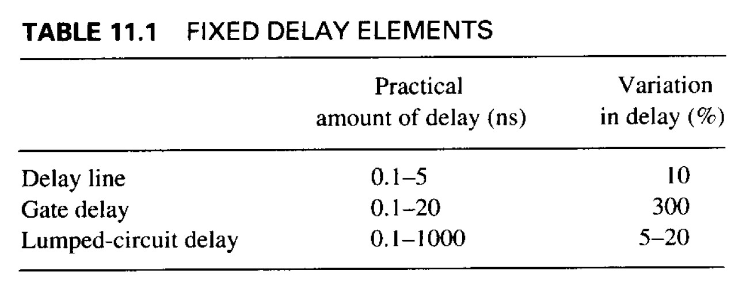
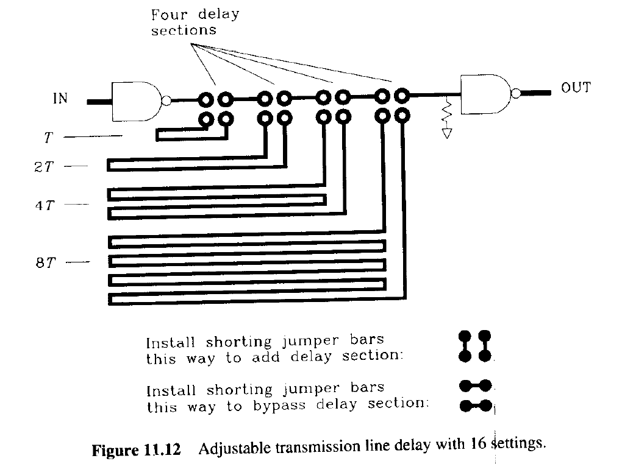
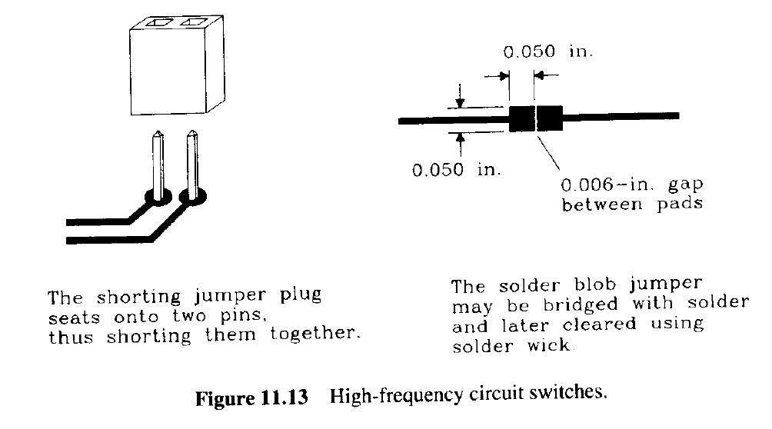
Delay Control Circuit for Experiment(1)
Is it possible to make without PCB?
Is inductance of jumper acceptable?

Slide 10
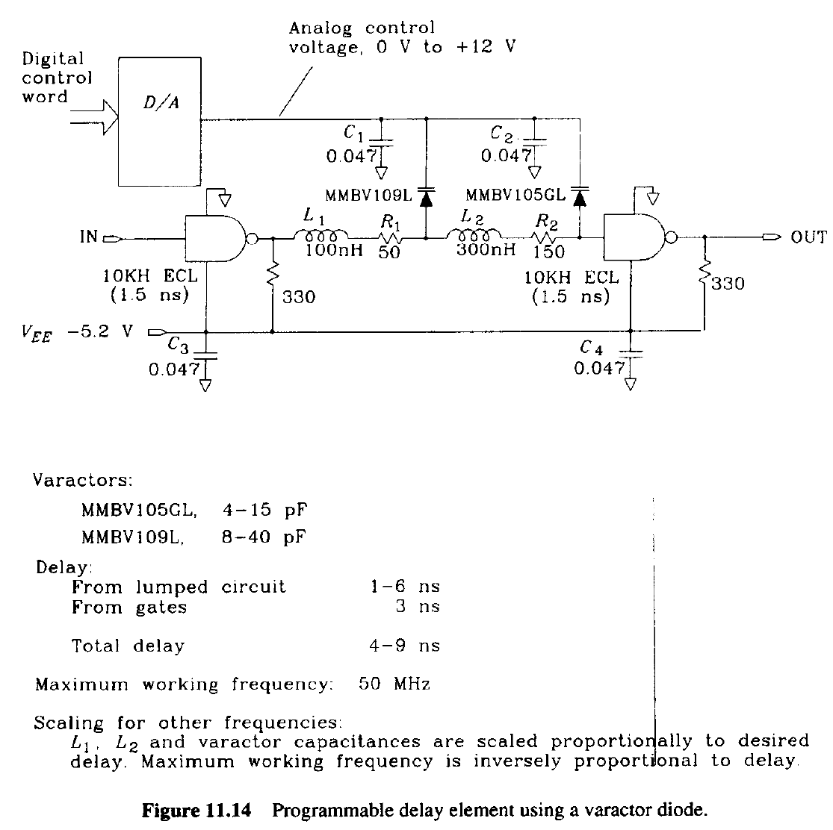
Delay Control Circuit for Experiment(2)
Breadboard inductance, capacitance does not matter?
Working frequency is to low!

Slide 11
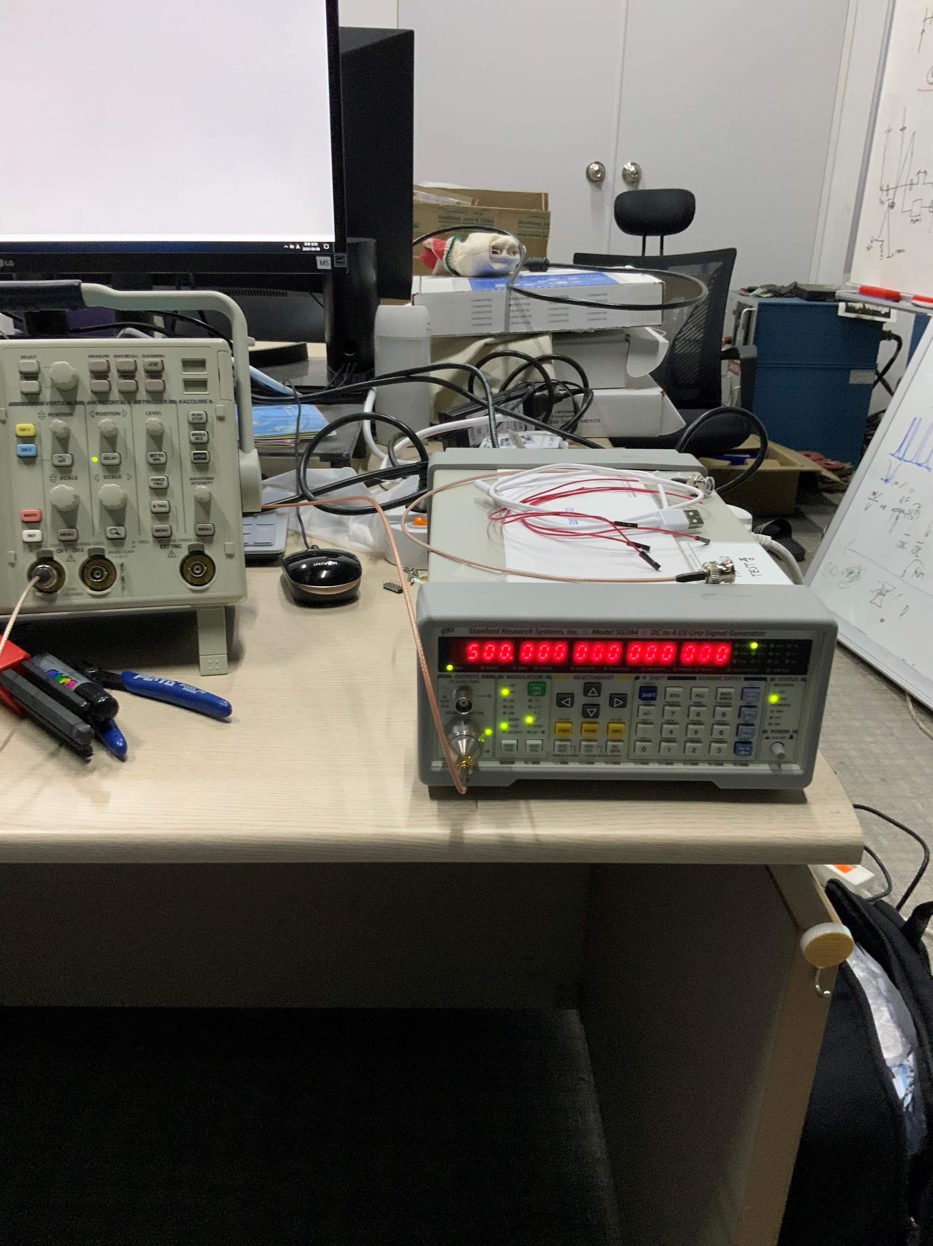
Delay Control Circuit for Experiment(3)
Use SG384(clock source) phase adjustment
Simple solution!

Slide 12
Experiment for Solution Validation
1GHz CLOCK
AD9910
spectrum analyzer
ARTYS7
D flip-flop
frequency
f1
f2
f3
f4
profile
000
010
001
011
Validation of our assumption

Slide 13
Solution1
ARTY S7
1ns control
AD9910
OSERDES
PROFILE
SYNC_OUT
ISERDES
SYNC_CLK
SYNC_IN
62.5MHz
AD9910
PROFILE
SYNC_OUT
SYNC_CLK
SYNC_IN
250MHz
No SERDES in Spartan7
Impossible!

Slide 14
Solution2
62.5MHz
ARTY S7
AD9910
control SYNC_IN delay
IOUPDATE
PROFILE
SYNC_OUT
PLL
SYNC_IN
62.5MHz
AD9910
IOUPDATE
SYNC_OUT
SYNC_IN
Does it work properly? (PLL jitter of FPGA is sufficiently low?)
If this makes noise to AC signal, is it worth that much?

Slide 15
Solution3
e.g.DS1023, MC100EP195B
or trace delay
Pmod Cable
FMC Cable
ARTY S7
PMOD
delay control
FMC
AD9910
IOUPDATE
PROFILE
SYNC_OUT
buffer
SYNC_IN
SPI
AD9910
62.5MHz
CPLD
IOUPDATE
PROFILE
SYNC_OUT
SPI
SYNC_IN
Digital
Power
Oscillator
New PCB should be made
No proper delay controller exist to control each signal(too expensive)-> should be made in trace

Slide 16
Solution4
ARTY S7
AD9910
IOUPDATE
PROFILE
SYNC_OUT
SPI
SYNC_IN
AD9910
62.5MHz
CLOCK SOURCE
delay control
IOUPDATE
PROFILE
SYNC_OUT
SPI
SYNC_IN
CPLD
Digital
Power
Oscillator
SYSCLK
New PCB should be made
Only one proper timing delay chip is required!
However we cannot use this solution if clock phase of FPGA and DDS board is not synchronized well…

Slide 17
Solution5
ARTY S7
AD9910
CPLD
IOUPDATE
PROFILE
SYNC_OUT
D flip-flop
(74AUP1G79)
SPI
SYNC_CLK
AD9910
62.5MHz
IOUPDATE
PROFILE
SYNC_OUT
Digital
Power
Oscillator
SPI
SYNC_IN
It just lower metastable probability, does not fix it..
But this seems to be sufficient in this problem!
https://www.mouser.kr/ProductDetail/Nexperia/74AUP1G79GV125?qs=jquClx72t9COASqZ9WZ81A%3D%3D

Slide 18
More improvement
NEW FPGA
CPLD
AD9910
LPF
Attenuator
Amplifier
SMA
IOUPDATE
PROFILE
OUTPUT
EXT
CLK
SYNC_OUT
CLK_DELAY
REF_CLK
SYNC_IN
AD9910
IOUPDATE
PROFILE
OUTPUT
CLK_DELAY
CLK_DELAY
CLK_DELAY
SYNC_OUT
CLK_DELAY
REF_CLK
SYNC_IN
AD9910
IOUPDATE
PROFILE
OUTPUT
SYNC_OUT
CLK_DELAY
REF_CLK
SYNC_IN
AD9910
External
Clock
IOUPDATE
PROFILE
OUTPUT
Oscillator
SYNC_OUT
CLK_DELAY
REF_CLK
SYNC_IN
CLK
DIVIDER

Slide 19
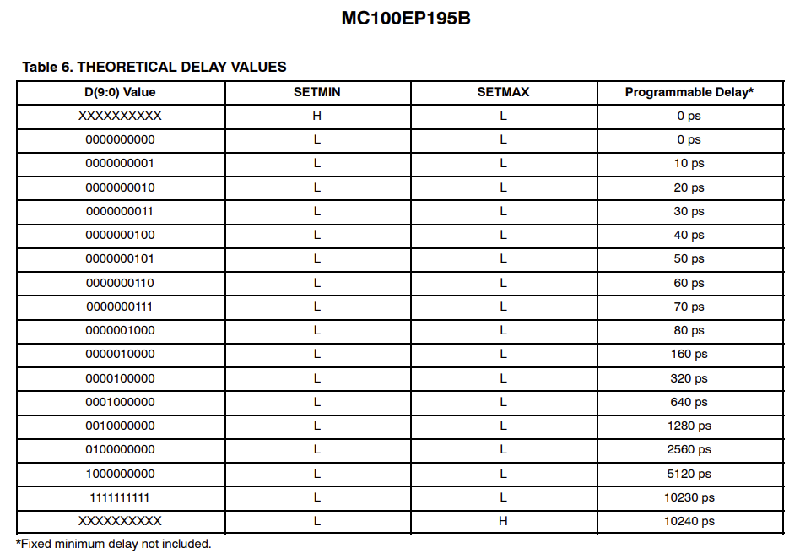
Clock delay chip
AD9515 -> 1GHz output does not work with delay adjustment
HMC856LC5 -> Nice but Too expensive!(~$300)

Slide 20
Clock delay chip
Chip | frequency [GHz] | delay step [ps] | total delay [ns] | jitter [ps] | INPUT | OUTPUT | Price [Won]
SY100EP195VTG | 1.6 | 10 | 2.1~10.8 | 0.2~1 | PECL, LVPECL, NECL, LVNECL | ECL | 20,000 | cont ctrl
SY100EP196VTG | 2.5 | 10 | 2.2~12.2 | 0.2~1 | PECL, LVPECL, NECL, LVNECL | PECL, NECL | 24,000 | cont ctrl
SY100E196JY | 1 | 20 | 1.2~3.3 | 5 | ECL | ECL? | 10,000 | cont ctrl
NB6L295 | 1.5 | 11 | 6~17.2 | 3 | LVPECL, CMS, LVDS | LVPECL, LVCMOS, LVTTL | 40,000 | SPI interface
MC100EP195 | 1.2 | 10 | 2.2~12.4 | 1.2 | LVCMOS, ECL, LVTTL | ECL? | 34,000
MC100EP195B | 1.2 | 10 | 2.2 | 1.1~5 | LVPECL, LVNECL, LVDS | ECL | 39,000
MC100EP196 | 1.2 | 10 | 2.2~12.2 | 3 | NECL, PECL | ECL | 23,000 | cont ctrl
MC100EP196B | 1.2 | 10 | 2.2~12.4 | 1.1~5 | NECL, PECL | ECL | 29,000 | cont ctrl
SY89295U | 1.5 | 10 | 3.3~14.8 | 2~10 | LVPECL | LVPECL | 20,000
SY89296U | 1.6 | 10 | 3.2~14.8 | 2~10 | LVPECL | LVPECL | 22,000
SY89297UMH | 1.6 | 5 | 2~7 | 1 | CML, LVPECL, LVDS | CML | 33,000 | SPI interface

Slide 21
Clock delay chip
Chip | frequency [GHz] | delay step [ps] | total delay [ns] | jitter [ps] | INPUT | OUTPUT | Price [Won]
SY100EP195VTG | 1.6 | 10 | 2.1~10.8 | 0.2~1 | PECL, LVPECL, NECL, LVNECL | ECL | 20,000 | cont ctrl
SY100EP196VTG | 2.5 | 10 | 2.2~12.2 | 0.2~1 | PECL, LVPECL, NECL, LVNECL | PECL, NECL | 24,000 | cont ctrl
SY100E196JY | 1 | 20 | 1.2~3.3 | 5 | ECL | ECL? | 10,000 | cont ctrl
NB6L295 | 1.5 | 11 | 6~17.2 | 3 | LVPECL, CMS, LVDS | LVPECL, LVCMOS, LVTTL | 40,000 | SPI interface
MC100EP195 | 1.2 | 10 | 2.2~12.4 | 1.2 | LVCMOS, ECL, LVTTL | ECL? | 34,000
MC100EP195B | 1.2 | 10 | 2.2 | 1.1~5 | LVPECL, LVNECL, LVDS | ECL | 39,000
MC100EP196 | 1.2 | 10 | 2.2~12.2 | 3 | NECL, PECL | ECL | 23,000 | cont ctrl
MC100EP196B | 1.2 | 10 | 2.2~12.4 | 1.1~5 | NECL, PECL | ECL | 29,000 | cont ctrl
SY89295U | 1.5 | 10 | 3.3~14.8 | 2~10 | LVPECL | LVPECL | 20,000
SY89296U | 1.6 | 10 | 3.2~14.8 | 2~10 | LVPECL | LVPECL | 22,000
SY89297UMH | 1.6 | 5 | 2~7 | 1 | CML, LVPECL, LVDS | CML | 33,000 | SPI interface
cont ctrl require additional circuit(e.g. DAC)

Slide 22
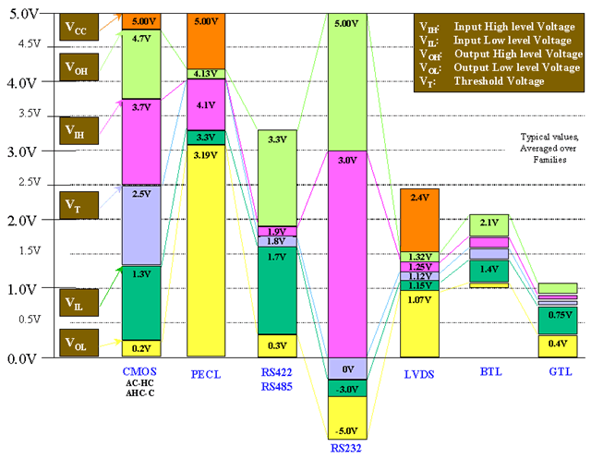
Voltage range

Slide 23
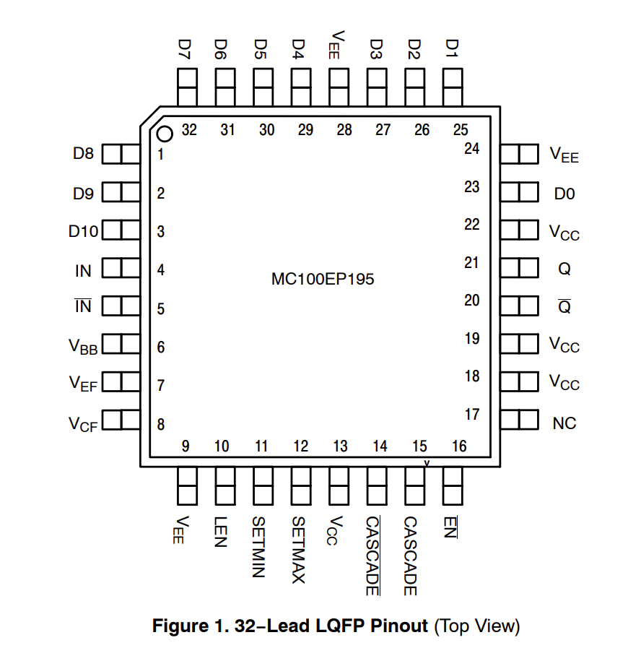
MC100EP195
D0~D10, LEN, EN, CASCADE*2 ->15
RF -> 1 (using invertor) or2
MAX : 15*4 + 2*5= 70 ( for 4 CLK)
-> extending to 7 CLK delay require more than 100 pins

Slide 24
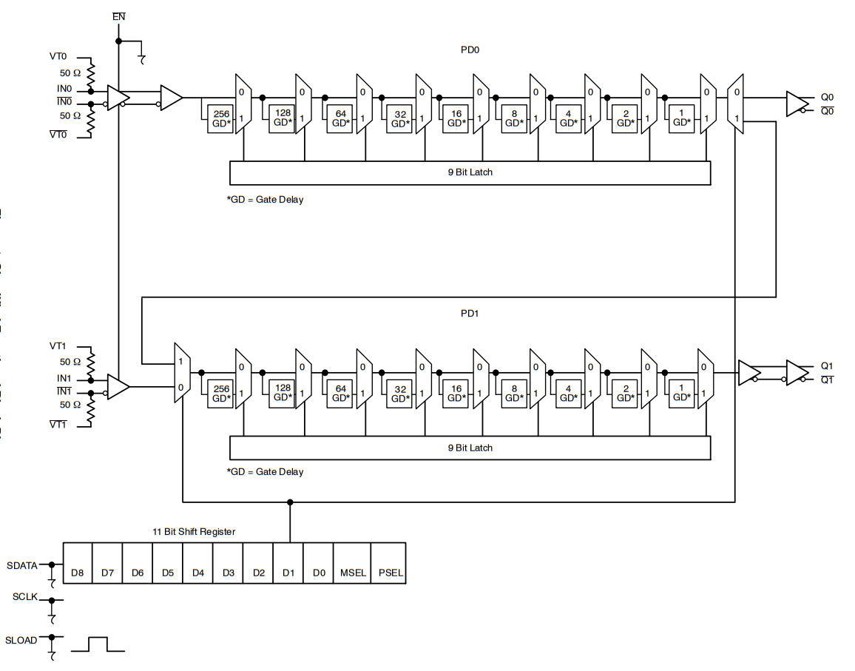
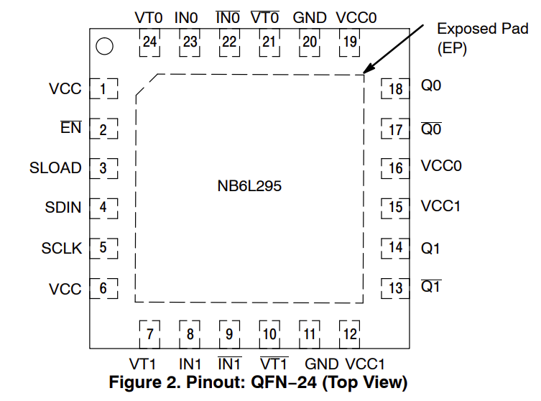
NB6L295
SDATA, SCLK, SLOAD, EN ->4
RF -> 1 (using invertor) or2
MAX : 4*4 + 2*5= 26 ( for 4 CLK)
-> extending to 7 CLK delay requires almost 28 pins

Slide 25
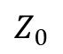
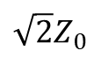
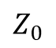
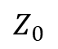
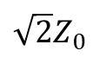
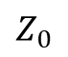
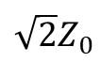
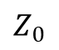
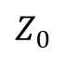
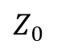
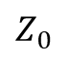
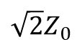
Circuit(1)
Impedance matched at all port
Total -6dBm loss
bypass capacitor
analog
voltage regulator
sma
-3dBm
delay chip
-3dBm
sma
$$Z_{0}$$
decoupling capacitor
$$Z_{0}$$
$${\sqrt{2}Z}_{0}$$
$${\sqrt{2}Z}_{0}$$
$$Z_{0}$$
$$Z_{0}$$
Ntype
$$Z_{0}$$
$$Z_{0}$$
Ntype
$$Z_{0}$$
$${\sqrt{2}Z}_{0}$$
$$Z_{0}$$
$${\sqrt{2}Z}_{0}$$
ground is separated
power is separated
shield
digital
CPLD
(XC9536XL or XC2C32A
or XC2C64A or XC2C128A)
jb_1 | jb_5
jb_2 | jb_6
jb_3 | jb_7
jb_4 | jb_8
GND | GND
VCC | VCC
5
1
6
2
7
3
8
4
decoupling capacitor
G
G
bypass capacitor
V
V
JTAG
voltage regulator
oscillator
SPDT

Slide 26
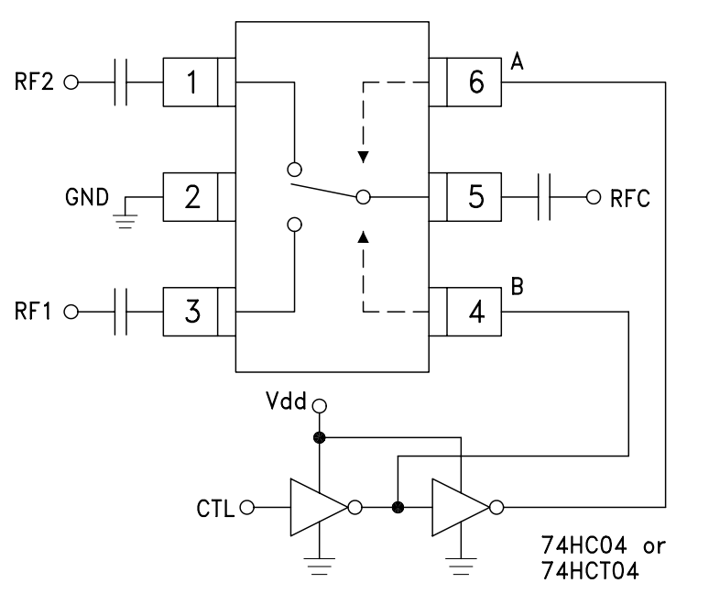
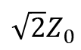
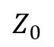
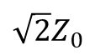
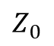
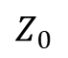
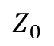
Wilkinson divider -> RF SPDT switch
$$Z_{0}$$
-3dBm
$${\sqrt{2}Z}_{0}$$
$$Z_{0}$$
$$Z_{0}$$
$$Z_{0}$$
$${\sqrt{2}Z}_{0}$$
HMC545A
QPC7522
HSWA2-30DR+
Low insertion loss
Digital signal in analog section increase
Does RF SPDT makes random jitter?

Slide 27
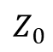
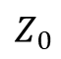
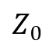
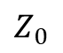
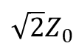
Circuit(2)
Total -6dBm loss
decoupling capacitor
bypass capacitor
analog
voltage regulator
$$Z_{0}$$
sma
sma
$$Z_{0}$$
NB6L295
-3dBm
$$Z_{0}$$
RF
SPDT
$$Z_{0}$$
NB6L295
Ntype
$$Z_{0}$$
$$Z_{0}$$
NB6L295
$${\sqrt{2}Z}_{0}$$
ground is separated
NB6L295
shield
power is separated
digital
XC2C128A
jb_1 | jb_5
jb_2 | jb_6
jb_3 | jb_7
jb_4 | jb_8
GND | GND
VCC | VCC
5
1
6
2
7
3
8
4
decoupling capacitor
G
G
bypass capacitor
V
V
JTAG
voltage regulator
oscillator
SPDT

Slide 28
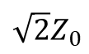
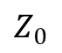
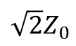
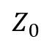
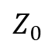
Circuit(3)
Impedance matched at all port
Total -6dBm loss
bypass capacitor
analog
voltage regulator
$$Z_{0}$$
decoupling capacitor
$$Z_{0}$$
sma
sma
NB6L295
-3dBm
$$Z_{0}$$
NB6L295
$$Z_{0}$$
NB6L295
$${\sqrt{2}Z}_{0}$$
ground is separated
NB6L295
shield
$${\sqrt{2}Z}_{0}$$
power is separated
digital
XC2C128A
jb_1 | jb_5
jb_2 | jb_6
jb_3 | jb_7
jb_4 | jb_8
GND | GND
VCC | VCC
5
1
6
2
7
3
8
4
decoupling capacitor
G
G
bypass capacitor
V
V
JTAG
voltage regulator
DC
oscillator

Slide 29
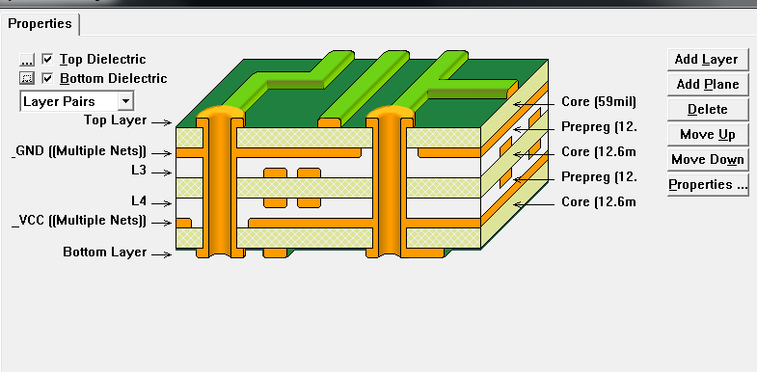
RF SPDT switch
B
RF1
RFc
GND
A
RF2
Top Layer
L4 layer
use 6 layer PCB
for equal timing length is lengthened

Slide 30
Program
PCB → Kicad 6.0
CPLD → ISE14.7 in Ubuntu 22.04.1LTS
FPGA → Vivado2017.3

Slide 31
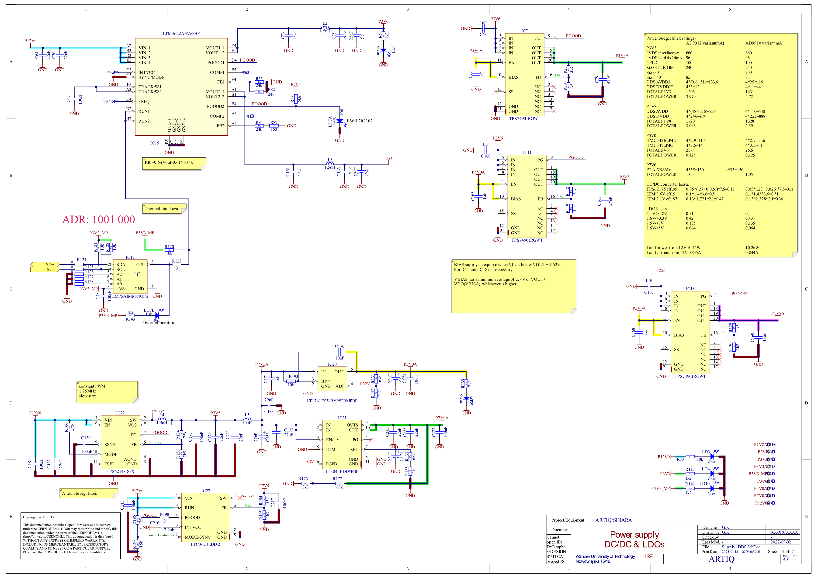
step down switching
low dropout linear regulator
temperature sensor & thermal watchdog
micropower
regulator
ultrahigh PSRR linear regulator
step down switch
step down switch

Slide 32
Regulator

Slide 33
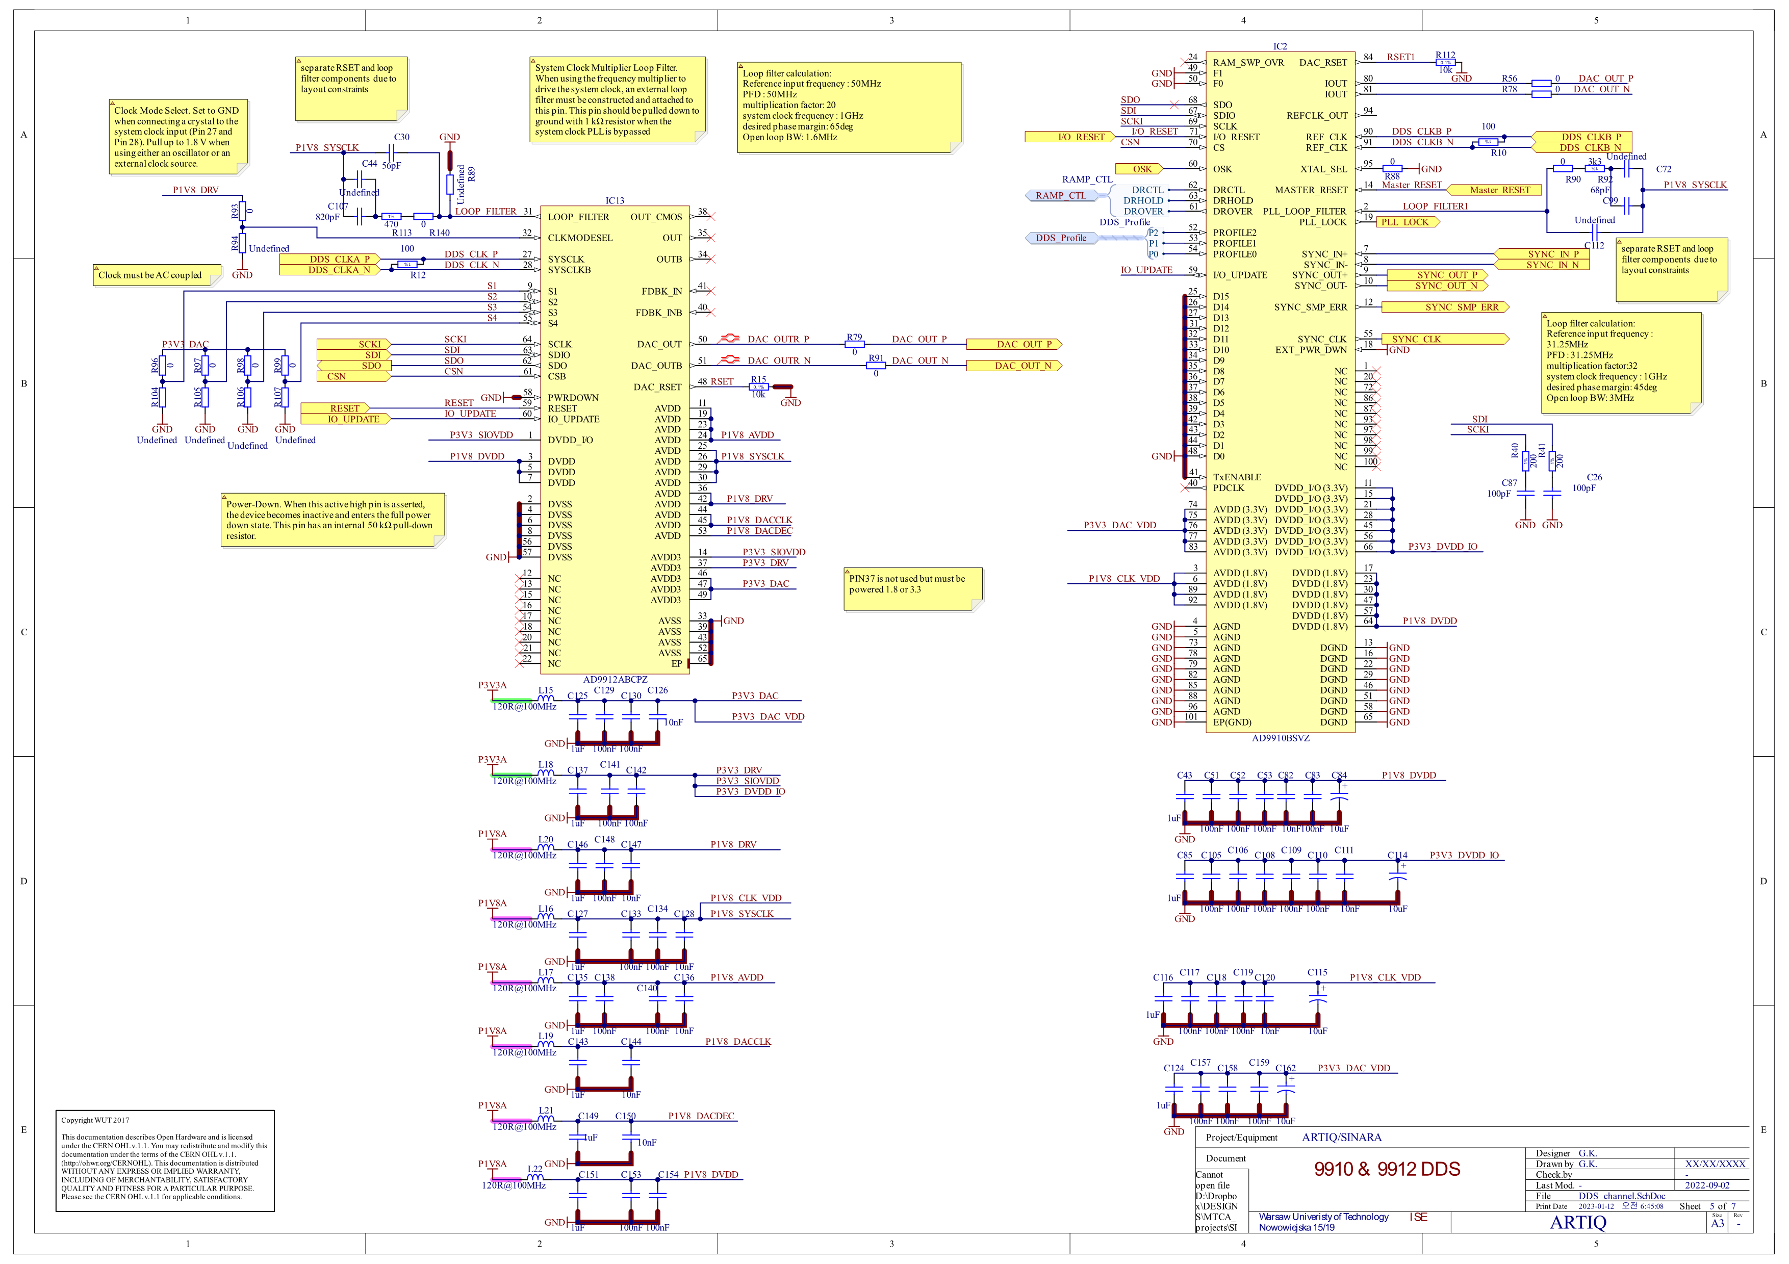
Bypass capacitor
decoupling capacitor
Noise suprress inductor

Slide 34
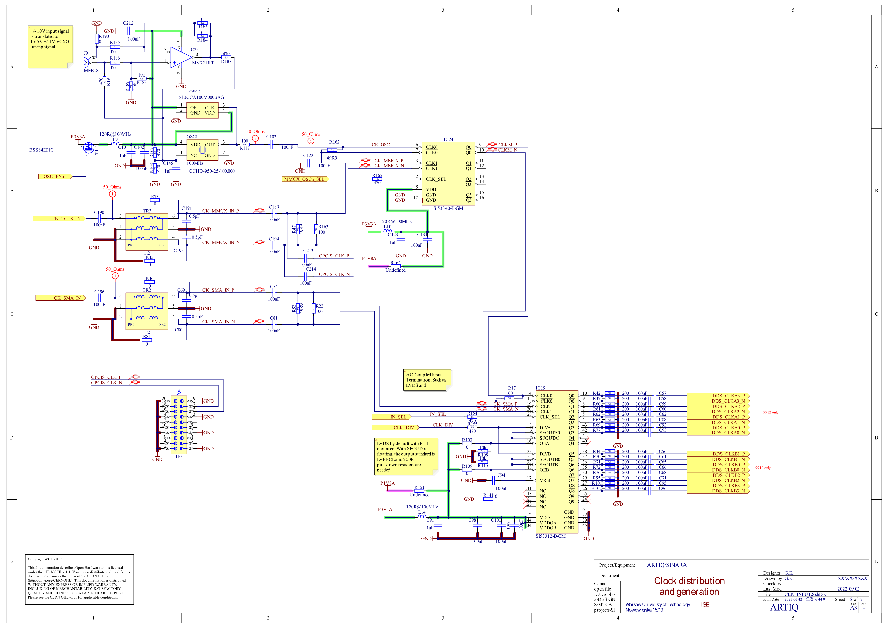

Slide 35
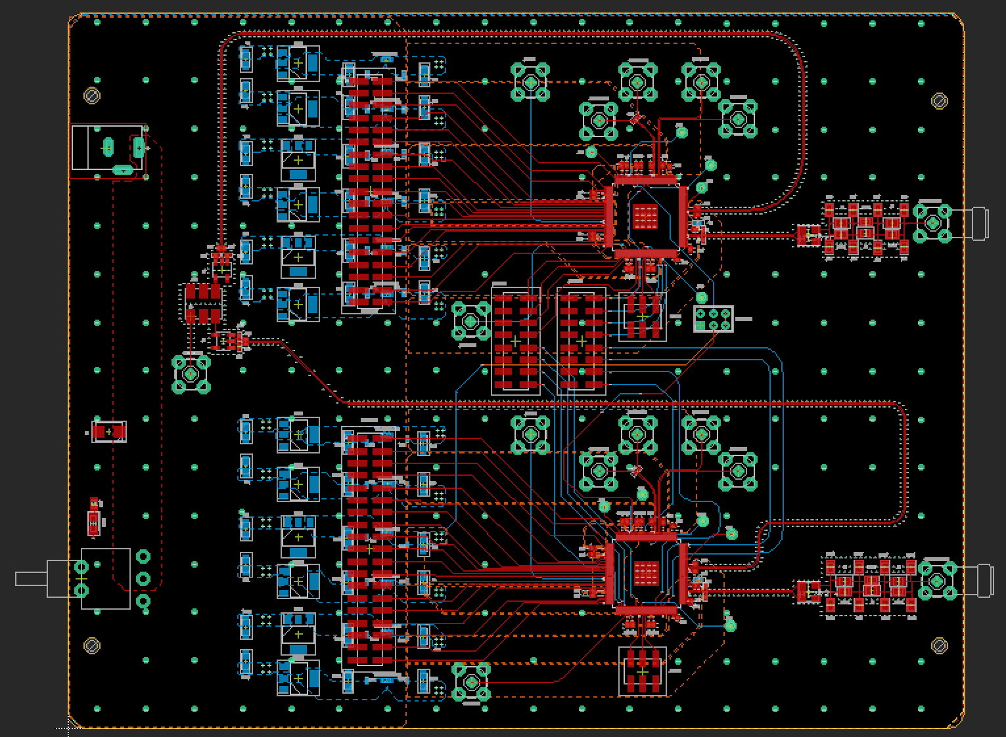
Synchronization of AD9910
SYNC pin should be used
SYNC_IN
SYNC_SMP_ERROR

Slide 36
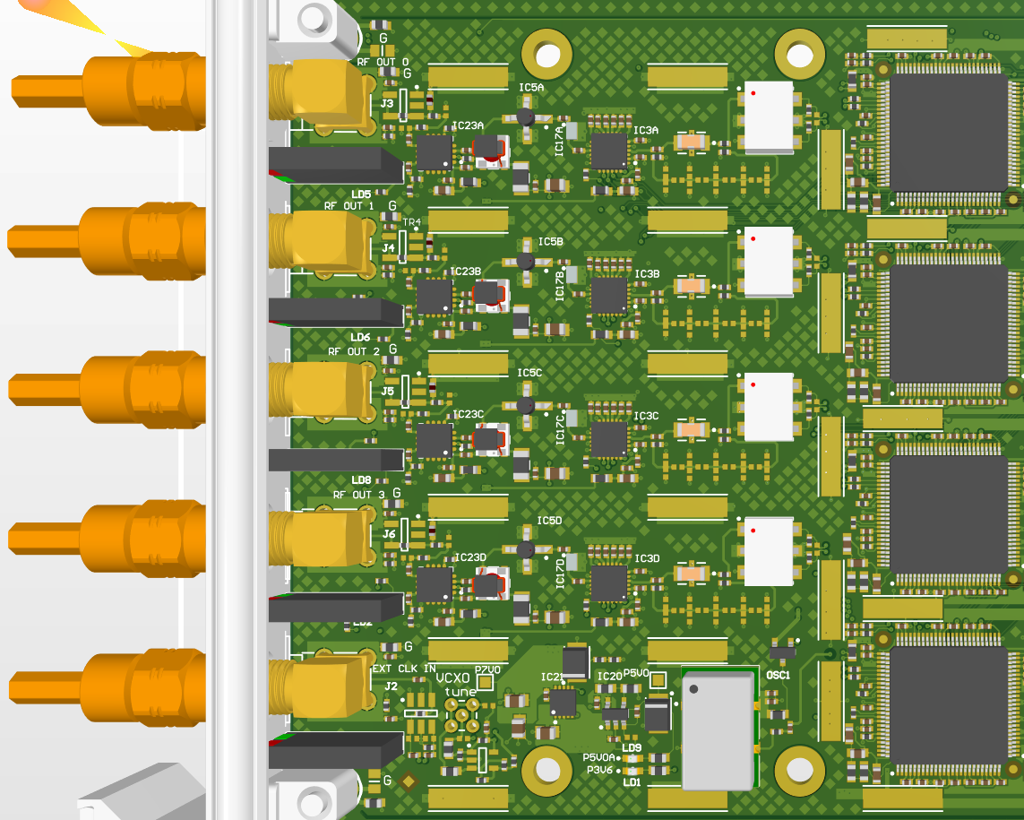
Urukul Board
Not seems to be considering RF effect that much

Slide 37
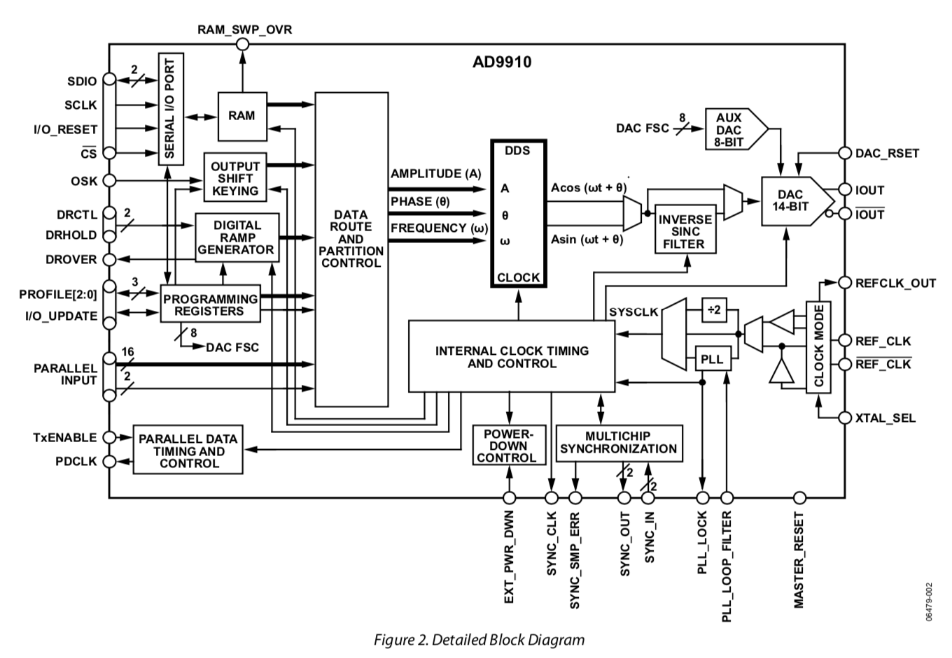
AD9910 Block diagram
Data I/O pin
OSK enable pin
DRG control pin
Output
Register select pin
FUD Pin
Clock input
Not used
Synchronization pin
(SYNC_IN != SYNC_CLK)

Slide 38
I/O update & SYNC_CLK timing
SYNC_CLK = SYS_CLK/4
SYNC_OUT = SYS_CLK/16 (Controllable)
SYS_CLK
(Same in DDS1,2)
DDS1 SYNC_CLK
DDS2 SYNC_CLK
Common I/O update
DDS1 sense I/O_UPDATE
DDS1 update register
Even with phase aligned SYS_CLK, synchornization can fail
DDS2 sense I/O_UPDATE
DDS2 update register

Slide 39


Synchronization of AD9910
Control SYNC_IN delay
Rising edge of SYNC_IN starts counter→ make
coincidence SYNC_CLK
Control skew of SYNC_IN, SYS_CLK
Check whether hold/setup
condition satisfies
SYS_CLK
metastable can occur
SYNC_CLK
when SYNC RECEIVER DELAY = 0
SYNC_CLK
when SYNC RECEIVER DELAY != 0
see https://ez.analog.com/dds/f/q-a/30165/ad9957-multichip-sync
SYNC RECEIVER DELAY

Slide 40

SYNC Validation
SETUP VALIDATION
Skew caused by SYNC_VALIDATION_DELAY
SYNC_IN
SYNC VALIDATION DELAY
SYS_CLK
SYNC_IN
SYS_CLK
SYNC VALIDATION DELAY
HOLD VALIDATION

Slide 41


Synchronizing
Case1
SYNC_SMP_ERR
SYNC_IN delay
0 1 2 3 4 5 6 7 8 9 10 11 12 13 14 15 16 17 18 19 20 21 22 23 24 25 26 27 28 29 30 31
Sync Validation delay
0
1
2
3
4
5
Case2
SYNC_IN delay
0 1 2 3 4 5 6 7 8 9 10 11 12 13 14 15 16 17 18 19 20 21 22 23 24 25 26 27 28 29 30 31
Sync Validation delay
0
1
2
3
4
5

Slide 42
tune_sync_delay function
759 @kernel
760 def tune_sync_delay(self, search_seed=15):
776 if not self.cpld.sync_div:
777 raise ValueError("parent cpld does not drive SYNC")
778 search_span = 31
781 min_window = 0
782 margin = 1
783 for window in range(16):
784 next_seed = -1
785 for in_delay in range(search_span - 2*window):
787 if in_delay & 1:
788 in_delay = -in_delay
789 in_delay = search_seed + (in_delay >> 1)
790 if in_delay < 0 or in_delay > 31:
791 continue
792 self.set_sync(in_delay, window)
793 self.clear_smp_err()
795 delay(100*us)
796 err = urukul_sta_smp_err(self.cpld.sta_read())
797 delay(100*us) # slack
798 if not (err >> (self.chip_select - 4)) & 1:
799 next_seed = in_delay
800 break
801 if next_seed >= 0:
802 search_seed = next_seed
803 continue
804 elif window > min_window:
806 window = max(min_window, window - 1 - margin)
807 self.set_sync(search_seed, window)
808 self.clear_smp_err()
809 delay(100*us)
810 return search_seed, window
811 else:
812 break
813 raise ValueError("no valid window/delay")

Slide 43
I/O_UPDATE delay
SYS_CLK
DDS SYNC_CLK
Even number of SYNC_CLK
Common I/O update
Odd Frequency
1FTW
Frequency can be odd or even
Odd Frequency
Even Frequency
FTW

Slide 44
I/O_UPDATE delay
SYS_CLK
DDS SYNC_CLK
Even number of SYNC_CLK
Common I/O update
I/O_UPDATE DELAY
Odd Frequency
1FTW
Frequency can be only even
Even Frequency
FTW

Slide 45
tune_io_update_delay function
882 @kernel
883 def tune_io_update_delay(self):
899 period = self.sysclk_per_mu * 4
900 repeat = 100
901 for i in range(period):
902 t = 0
904 for j in range(repeat):
905 t += self.measure_io_update_alignment(i, i + 2)
906 if t != 0:
907 continue
909 t1 = [0, 0]
910 for j in range(repeat):
911 t1[0] += self.measure_io_update_alignment(i, i + 1)
912 t1[1] += self.measure_io_update_alignment(i + 1, i + 2)
913 if ((t1[0] == 0 and t1[1] == 0) or
914 (t1[0] == repeat and t1[1] == repeat)):
916 raise ValueError("no clear IO_UPDATE-SYNC_CLK alignment edge found")
918 else:
920 return (i + 1 + period//2) & (period - 1)
921 raise ValueError("no IO_UPDATE-SYNC_CLK alignment edge found")

Slide 46
measure_io_update_alignment function
815 @kernel
816 def measure_io_update_alignment(self, delay_start, delay_stop):
830 self.set_cfr1(drg_load_lrr=1, drg_autoclear=1)
832 self.write32(_AD9910_REG_CFR2, 0x01090000)
859 self.write64(_AD9910_REG_RAMP_LIMIT, -1, 0)
861 self.write32(_AD9910_REG_RAMP_RATE, 0x00010000)
863 self.write64(_AD9910_REG_RAMP_STEP, -1, 0)
865 t = now_mu() + 8 & ~7
866 at_mu(t + delay_start)
868 self.cpld.io_update.pulse_mu(16 - delay_start)
870 self.set_cfr1()
872 self.write64(_AD9910_REG_RAMP_STEP, 0, 0)
873 at_mu(t + 0x1000 + delay_stop)
874 self.cpld.io_update.pulse_mu(16 - delay_stop)
875 ftw = self.read32(_AD9910_REG_FTW)
876 delay(100*us)
878 self.write32(_AD9910_REG_CFR2, 0x01010000)
879 self.cpld.io_update.pulse_mu(8)
880 return ftw & 1

Slide 47
Urukul:AD9910 Parameter Control(1)
1 from artiq.experiment import *
2
3
4 class DDSTest(EnvExperiment):
5 def build(self):
6 self.setattr_device("core")
7 self.setattr_device("urukul0_cpld")
8 self.urukul_dds0 = self.get_device("urukul0_ch0")
9
10 @kernel
11 def run(self):
14 self.urukul0_cpld.init()
15
16 delay(1*ms)
17 self.urukul_dds0.init()
18
19 self.urukul_dds0.set(frequency = 100*MHz, phase = 0.0, profile = 0)
20 self.urukul_dds0.set(frequency = 150*MHz, phase = 0.0, profile = 1)
21 self.urukul_dds0.set(frequency = 200*MHz, phase = 0.0, profile = 2)
22 self.urukul_dds0.set(frequency = 200*MHz, phase = 0.5, profile = 3)
23 self.urukul_dds0.sw.on()
24
profile | frequency | phase | amplitude
0 | 100MHz | 0 | 1.0
1 | 150MHz | 0 | 1.0
2 | 200MHz | 0 | 1.0
3 | 200MHz | pi | 1.0

Slide 48
Urukul:AD9910 Parameter Control(2)
25 delay(0.01*us)
26 self.urukul0_cpld.set_profile(profile = 1)
27 self.urukul_dds0.set_att(6.)
28
29 delay(0.01*us)
30 self.urukul0_cpld.set_profile(profile = 2)
31
32 delay(0.01*us)
33 self.urukul0_cpld.set_profile(profile = 3)
34
35 delay(0.01*us)
36 self.urukul_dds0.sw.off()
set which profile register to supply parameter
profile | frequency | phase | amplitude
0 | 100MHz | 0 | 1.0
1 | 150MHz | 0 | 1.0
2 | 200MHz | 0 | 1.0
3 | 200MHz | pi | 1.0

Slide 49
Urukul:AD9910 Parameter Control(2)
25 delay(0.01*us)
26 self.urukul0_cpld.set_profile(profile = 1)
27 self.urukul_dds0.set_att(6.)
28
29 delay(0.01*us)
30 self.urukul0_cpld.set_profile(profile = 2)
31
32 delay(0.01*us)
33 self.urukul0_cpld.set_profile(profile = 3)
34
35 delay(0.01*us)
36 self.urukul_dds0.sw.off()
set which profile register to supply parameter
profile | frequency | phase | amplitude
0 | 100MHz | 0 | 1.0
1 | 150MHz | 0 | 1.0
2 | 200MHz | 0 | 1.0
3 | 200MHz | pi | 1.0

Slide 50
Urukul:AD9910 Parameter Control(2)
25 delay(0.01*us)
26 self.urukul0_cpld.set_profile(profile = 1)
27 self.urukul_dds0.set_att(6.)
28
29 delay(0.01*us)
30 self.urukul0_cpld.set_profile(profile = 2)
31
32 delay(0.01*us)
33 self.urukul0_cpld.set_profile(profile = 3)
34
35 delay(0.01*us)
36 self.urukul_dds0.sw.off()
set which profile register to supply parameter
profile | frequency | phase | amplitude
0 | 100MHz | 0 | 1.0
1 | 150MHz | 0 | 1.0
2 | 200MHz | 0 | 1.0
3 | 200MHz | pi | 1.0

Slide 51
Urukul:AD9910 RAM Mode(1)
1 from artiq.experiment import *
2
3
4 class DDSTest(EnvExperiment):
5 def build(self):
6 self.setattr_device("core")
7 self.setattr_device("urukul0_cpld")
8 self.urukul_dds0 = self.get_device("urukul0_ch0")
9
10 @kernel
11 def run(self):
14 self.urukul0_cpld.init()
15 delay(1*ms)
16
17 self.urukul_dds0.init()
18 delay(1*us)
19
20 self.urukul_dds0.set_profile_ram(start = 0, end = 3, step = 2, profile = 0, nodwell_high = 0, zero_crossing = 0, mode = 1)
21 delay(1*us)
22
23 self.urukul_dds0.set_profile_ram(start = 4, end = 7, step = 1, profile = 1, nodwell_high = 0, zero_crossing = 0, mode = 1)
24 delay(1*us)
25
26 self.urukul_dds0.set_profile_ram(start = 8, end = 11, step = 2, profile = 2, nodwell_high = 0, zero_crossing = 0, mode = 1)
27
set profile for ram mode

Slide 52
Urukul:AD9910 RAM Mode(2)
28 ram_data_SI = [
29 50*MHz, 60*MHz, 70*MHz, 80*MHz, 90*MHz, 100*MHz, 110*MHz, 120*MHz, 130*MHz, 140*MHz, 150*MHz, 160*MHz
30 ]
31 ram_data_MU = list()
32
33 self.urukul_dds0.frequency_to_ram(ram_data_SI, ram_data_MU)
34 self.urukul_dds0.write_ram(ram_data_MU)
35
36 self.urukul_dds0.set_asf( self.urukul_dds0.amplitude_to_asf( amplitude = 1.0 ) )
37 self.urukul_dds0.set_pow( self.urukul_dds0.turns_to_pow( turns = 0.0 ) )
38
39 self.urukul_dds0.set_cfr1(power_down = 0b0000,
40 phase_autoclear = 0,
41 drg_load_lrr = 0,
42 drg_autoclear = 0,
43 internal_profile = 0,
44 ram_destination = 0,
45 ram_enable = 1,
46 )
47
48 delay(0.1*us)
49
50 self.urukul_dds0.sw.on()
51 self.cpld.io_update.pulse(1*us)
frequency to save in RAM with SI unit
frequency to save in RAM with machine unit
RAM | DATA
0 | 50MHz
1 | 60MHz
2 | 70MHz
3 | 80MHz
4 | 90MHz
5 | 100MHz
6 | 110MHz
7 | 120MHz
8 | 130MHz
9 | 140MHz
10 | 150MHz
11 | 160MHz
save amplitude, phase to supply
in RAM mode
set Control Function Register
to RAM mode
IO update

Slide 53
Urukul:AD9910 Synchronization Code(1)
1 from artiq.experiment import *
2
3 _AD9910_REG_PROFILE0 = 0x0e
4 _AD9910_REG_PROFILE1 = 0x0f
5 _AD9910_REG_PROFILE2 = 0x10
6 _AD9910_REG_PROFILE3 = 0x11
7 _AD9910_REG_PROFILE4 = 0x12
8 _AD9910_REG_PROFILE5 = 0x13
9 _AD9910_REG_PROFILE6 = 0x14
10 _AD9910_REG_PROFILE7 = 0x15
11
12
13 class DDSTest(EnvExperiment):
14 def build(self):
15 self.setattr_device("core")
16 self.setattr_device("urukul0_cpld")
17 self.dds_set = [ self.get_device("urukul0_ch" + str(i)) for i in range(4) ]
18
19 @kernel
20 def run(self):
23 self.urukul0_cpld.init()
24 delay(1*ms)
25
26 for dds in self.dds_set:
27 dds.init()
28 delay(1*ms)
29

Slide 54
Urukul:AD9910 Synchronization Code(1)
1 from artiq.experiment import *
2
3 _AD9910_REG_PROFILE0 = 0x0e
4 _AD9910_REG_PROFILE1 = 0x0f
5 _AD9910_REG_PROFILE2 = 0x10
6 _AD9910_REG_PROFILE3 = 0x11
7 _AD9910_REG_PROFILE4 = 0x12
8 _AD9910_REG_PROFILE5 = 0x13
9 _AD9910_REG_PROFILE6 = 0x14
10 _AD9910_REG_PROFILE7 = 0x15
11
12
13 class DDSTest(EnvExperiment):
14 def build(self):
15 self.setattr_device("core")
16 self.setattr_device("urukul0_cpld")
17 self.dds_set = [ self.get_device("urukul0_ch" + str(i)) for i in range(4) ]
18
19 @kernel
20 def run(self):
23 self.urukul0_cpld.init()
24 delay(1*ms)
25
26 for dds in self.dds_set:
27 dds.init()
28 delay(1*ms)
29

Slide 55
Urukul:AD9910 Synchronization Code(2)
variable to calculate average IO_UPDATE signal delay
30 temp_sum = 0
31 amplitude = [0.4, 0.6, 0.8, 1.0]
32 freq = [50*MHz, 80*MHz, 110*MHz, 140*MHz]
33 phase = [0.0, 0.2, 0.4, 0.6]
34 attenuation = [ 6.0, 12.0, 18.0, 24.0 ]
35
36 for i in range(4):
37 temp_sync_delay, temp_validation_delay = self.dds_set[i].tune_sync_delay()
38 delay(1*ms)
39 temp_io_update_delay = self.dds_set[i].tune_io_update_delay()
40 self.dds_set[i].sync_data.sync_delay_seed = temp_sync_delay
41 self.dds_set[i].sync_data.io_update_delay = temp_validation_delay
42 temp_sum += temp_io_update_delay
43 temp_asf = self.dds_set[i].amplitude_to_asf(amplitude[i])
44 temp_ftw = self.dds_set[i].frequency_to_ftw(freq[i])
45 temp_pow = self.dds_set[i].turns_to_pow(phase[i])
46 profile_num = _AD9910_REG_PROFILE0 + i
47 self.dds_set[i].write64( profile_num, ( ( temp_asf & 0x3fff ) << 16 ) | ( temp_pow & 0xffff ), temp_ftw & 0xffffffff )
48 delay(1*us)
49 self.dds_set[i].set_att(attenuation[i])
50 delay(1*us)
51
parameters to set DDS
find and set proper SYNC_IN delay for each DDS
find and set proper IO_UPDATE delay for each DDS

Slide 56
Urukul:AD9910 Synchronization Code(3)
52 io_update_delay_avg = int64(round(temp_sum/4))
53
54 t = now_mu() + int64(8) + io_update_delay_avg
55 at_mu(t)
56 self.urukul0_cpld.io_update.pulse_mu(8)
57
58 for dds in self.dds_set:
59 dds.sw.on()

Slide 57
Urukul DeviceDB(1)
1 core_addr = "192.168.1.70"
2
3 device_db = {
4 "core": {
5 "type": "local",
6 "module": "artiq.coredevice.core",
7 "class": "Core",
8 "arguments": {"host": core_addr, "ref_period": 1/(8*150e6)}
9 },
10 "core_log": {
11 "type": "controller",
12 "host": "::1",
13 "port": 1068,
14 "command": "aqctl_corelog -p {port} --bind {bind} " + core_addr
15 },
16 "core_cache": {
17 "type": "local",
18 "module": "artiq.coredevice.cache",
19 "class": "CoreCache"
20 },
21 "core_dma": {
22 "type": "local",
23 "module": "artiq.coredevice.dma",
24 "class": "CoreDMA"
25 },
26 }
27
module where class is declared
class to reference
arguments for class
-host : host IP
-ref_period : clock period of RTIO

Slide 58
Urukul DeviceDB(2)
28 for i in range(8):
29 device_db["ttl" + str(i)] = {
30 "type": "local",
31 "module": "artiq.coredevice.ttl",
32 "class": "TTLInOut" if i < 4 else "TTLOut",
33 "arguments": {"channel": 1+i},
34 }
35
36 device_db.update(
37 spi_urukul0={
38 "type": "local",
39 "module": "artiq.coredevice.spi2",
40 "class": "SPIMaster",
41 "arguments": {"channel": 9}
42 },
43 ttl_urukul0_io_update={
44 "type": "local",
45 "module": "artiq.coredevice.ttl",
46 "class": "TTLOut",
47 "arguments": {"channel": 10}
48 },
49 ttl_urukul0_sw0={
50 "type": "local",
51 "module": "artiq.coredevice.ttl",
52 "class": "TTLOut",
53 "arguments": {"channel": 11}
54 },
SPI interface pin (4-wire)
IO_UPDATE pin
RF switch pin

Slide 59
DeviceDB(3)
55 ttl_urukul0_sw1={
56 "type": "local",
57 "module": "artiq.coredevice.ttl",
58 "class": "TTLOut",
59 "arguments": {"channel": 12}
60 },
61 ttl_urukul0_sw2={
62 "type": "local",
63 "module": "artiq.coredevice.ttl",
64 "class": "TTLOut",
65 "arguments": {"channel": 13}
66 },
67 ttl_urukul0_sw3={
68 "type": "local",
69 "module": "artiq.coredevice.ttl",
70 "class": "TTLOut",
71 "arguments": {"channel": 14}
72 },
73 urukul0_cpld={
74 "type": "local",
75 "module": "artiq.coredevice.urukul",
76 "class": "CPLD",
77 "arguments": {
78 "spi_device": "spi_urukul0",
79 "io_update_device": "ttl_urukul0_io_update",
80 "refclk": 150e6,
81 "clk_sel": 2
82 }
83 }
84 )
RF Switch (HMC349ALP4CE)
Preamp (ERA-3SM+)
Attenuator chip (HMC542BLP4E)
Low pass filter (LFCN-320 or User Defined)
AD9910 chip
CPLD chip (XC2C256-6FTG256C)
Internal Clock (MMCX) -> FPGA
Onboard Oscillator (CCHD950)
External Clock (SMA)
SPI bus for CPLD
IO update channel
select clock source
-0 : Onboard 100MHz Osillator
-1 : External SMA
-2 : Internal MMCX

Slide 60
DeviceDB(3)
86 device_db["urukul0_ch0"] = {
87 "type": "local",
88 "module": "artiq.coredevice.ad9912",
89 "class": "AD9912",
90 "arguments": {
91 "pll_n": 4,
92 "chip_select": 4,
93 "cpld_device": "urukul0_cpld",
94 "sw_device": "ttl_urukul0_sw0",
95 }
96 }
97
98 device_db["urukul0_ch1"] = {
99 "type": "local",
100 "module": "artiq.coredevice.ad9912",
101 "class": "AD9912",
102 "arguments": {
103 "pll_n": 4,
104 "chip_select": 5,
105 "cpld_device": "urukul0_cpld",
106 "sw_device": "ttl_urukul0_sw0",
107 }
108 }
109
110 device_db["urukul0_ch2"] = {
111 "type": "local",
112 "module": "artiq.coredevice.ad9912",
113 "class": "AD9912",
114 "arguments": {
115 "pll_n": 4,
116 "chip_select": 6,
117 "cpld_device": "urukul0_cpld",
118 "sw_device": "ttl_urukul0_sw0",
119 }
120 }
121
122 device_db["urukul0_ch3"] = {
123 "type": "local",
124 "module": "artiq.coredevice.ad9912",
125 "class": "AD9912",
126 "arguments": {
127 "pll_n": 4,
128 "chip_select": 7,
129 "cpld_device": "urukul0_cpld",
130 "sw_device": "ttl_urukul0_sw0",
131 }
132 }
PLL multiply factor
CPLD driver
RF switch driver

Slide 61
AD9912 constructor
11 class AD9912:
30 def __init__(self, dmgr, chip_select, cpld_device, sw_device=None, pll_n=10):
31
32 self.cpld = dmgr.get(cpld_device)
33 self.core = self.cpld.core
34 self.bus = self.cpld.bus
35 assert 4 <= chip_select <= 7
36 self.chip_select = chip_select
37 if sw_device:
38 self.sw = dmgr.get(sw_device)
39 self.kernel_invariants.add("sw")
40 self.pll_n = pll_n
41 sysclk = self.cpld.refclk/[1, 1, 2, 4][self.cpld.clk_div]*pll_n
42 assert sysclk <= 1e9
43 self.ftw_per_hz = 1/sysclk*(int64(1) << 48)
44
set SYSCLK of DDS -> in this case SYSCLK = 600MHz

Slide 62
Urukul:AD9912 Parameter Control(1)
1 from artiq.experiment import *
2
3
4 class DDSTest(EnvExperiment):
5 def build(self):
6 self.setattr_device("core")
7 self.setattr_device("urukul0_cpld")
8 self.urukul_dds0 = self.get_device("urukul0_ch0")
9 self.urukul_dds1 = self.get_device("urukul0_ch1")
10 self.urukul_dds2 = self.get_device("urukul0_ch2")
11 self.urukul_dds3 = self.get_device("urukul0_ch3")
12
13 @kernel
14 def run(self):
17 self.urukul0_cpld.init()
18
19 delay(1*ms)
20 self.urukul_dds0.init()
21 delay(1*ms)
22 self.urukul_dds1.init()
23 delay(1*ms)
24 self.urukul_dds2.init()
25 delay(1*ms)
26 self.urukul_dds3.init()
27 delay(1*ms)

Slide 63
Urukul:AD9912 Parameter Control(2)
29 self.urukul_dds0.set(frequency = 100*MHz, phase = 0.0)
30 self.urukul_dds0.sw.on()
31 delay(0.1*us)
32 #self.urukul_dds0.cfg_sw(1)
33 self.urukul_dds1.set(frequency = 100*MHz, phase = 0.5)
34 self.urukul_dds1.sw.on()
35 delay(0.1*us)
36 self.urukul_dds2.set(frequency = 200*MHz, phase = 0.0)
37 self.urukul_dds2.sw.on()
38 delay(0.1*us)
39 self.urukul_dds3.set(frequency = 200*MHz, phase = 0.75)
40 self.urukul_dds3.sw.on()
41 delay(0.1*us)
42
43 self.urukul_dds0.set_att(6.0)
44 self.urukul_dds1.set_att(12.0)
45 self.urukul_dds2.set_att(18.0)
46 self.urukul_dds3.set_att(24.0)
change CPLD register value
-actual gain = +23 – 0.5 – 0.5 – 6 – 9 = +7dB
CPLD
chip
SMA output
DDS chip
balun
-0.5dB
LPF
-0.5dB
attenuator
-0~31.5dB
Amp
+23dB
(P1dB +13dBm)
T-pad
-9dB

Slide 64
Urukul:AD9912 Parameter Control(2)
29 self.urukul_dds0.set(frequency = 100*MHz, phase = 0.0)
30 self.urukul_dds0.sw.on()
31 delay(0.1*us)
32 #self.urukul_dds0.cfg_sw(1)
33 self.urukul_dds1.set(frequency = 100*MHz, phase = 0.5)
34 self.urukul_dds1.sw.on()
35 delay(0.1*us)
36 self.urukul_dds2.set(frequency = 200*MHz, phase = 0.0)
37 self.urukul_dds2.sw.on()
38 delay(0.1*us)
39 self.urukul_dds3.set(frequency = 200*MHz, phase = 0.75)
40 self.urukul_dds3.sw.on()
41 delay(0.1*us)
42
43 self.urukul_dds0.set_att(6.0)
44 self.urukul_dds1.set_att(12.0)
45 self.urukul_dds2.set_att(18.0)
46 self.urukul_dds3.set_att(24.0)
change CPLD register value
-actual gain = +23 – 0.5 – 0.5 – 6 – 9 = +7dB
CPLD
chip
SMA output
DDS chip
balun
-0.5dB
LPF
-0.5dB
attenuator
-0~31.5dB
Amp
+23dB
(P1dB +13dBm)
T-pad
-9dB

Slide 65

Urukul Output Channel Circuit

Slide 66
Things to be considered
Phase of RF signal to AOM is important…?
200MHz -> l = 1.5m -> l/6= 25cm => RF effect considerable?
Frequency value should be written in integer(float number is not exact)
Vivado version 2019.1 or 2017.3?
Clock on board
LPF Chip
Attenuator with Amplifier
Connector on board

Slide 67
Things doing
ILA on IOBUF does not work->let’s debug I, O pin separately
ILA debug -> (* mark_debug = “true” * )

Slide 68
To Fix Noise Problem
Insert attenuator, amplifier
Anlog signal -> high Q
Digital signal -> low Q
Clock length should be more shortened! (long trace -> high L -> high interference)
Digital power, analog ground segmented? -> if not, should be done
Decoupling capacitor should be placed

Slide 69
Pin
VCC | GND | ja_3 SCLK | ja_2 IOUP2 | ja_1 SDIO2 | ja_0 CSB2
VCC | GND | ja_7 IOUP1 | ja_6 SDIO1 | ja_5 CSB1 | ja_4 PO[18]
GND | PROF1[2] jb_7
GND | PROF1[1] jb_6
GND | PROF1[0] jb_5
GND | IO_UPDATE1 ja_7
GND | IO_UPDATE2
GND | PROF2[0]
GND | PROF2[1]
GND | PROF2[2]
GND | RESET1
GND | SDIO1 ja_6
GND | SCLK1 ja_3
GND | CSB1 ja_5
GND | CSB2
GND | SCLK2
GND | SDIO2
GND | RESET2
VCC | GND | jb_3 P2[1] | jb_2 P2[0] | jb_1 PO[17] | jb_0 PO[16]
VCC | GND | jb_7 P1[2] | jb_6 P1[1] | jb_5 P1[0] | jb_4 P2[2]

Slide 70
PCB Problem
1. Clock RF circuit does not work properly!
-> impedance due to via, resitor position is not proper
2. Clock trace and output trace is too close
-> feed through problem occurs
3. Filter can be replaced to IC
4. Digital, analog ground should be separated
5. Decoupling capacitor should be placed to pin more closely
-> Farther decoupling capacitance, more high parasitic inductance.

